Slide 1
Determining Gender in the Enron Email Corpus via Information Clustering Techniques
Mike Corbin
Patrick Trinkle
(corbin2|tri1)@umbc.edu
University of Maryland Baltimore County
1000 Hilltop Circle
Baltimore, MD 21250

Slide 2
Problem
Given a corpus of emails written in a mixed gender environment can the frequency of usage of certain words determine gender?

Slide 3
Previous Work
A similar problem is authorship attribution
There has been work that uses statistics of stop words to prove the author of a document with other works of theirs as input
The author of the 15th book of the Wizard of Oz has been statistically determined in this method
The author attribution problem is typically performed on larger works

Slide 4
Background
People use certain phrases more frequently than other, etc. However, this information is easily forged.
Words people use unconsciously such as stop words are harder to mimic. The stop words vary based on not just what is said but how it is said.
Given enough documents from a particular author or set of authors it is feasible to separate the authors by stop word usage

Slide 5
Background (cont.)
Using the vector space model of corpus representation where the dimension is how many terms are examine, the documents are vectors in the hyperspace
If each user’s documents are mapped into hyperspace they should plot near each other based on word usage

Slide 6
Background (cont.)
For our purposes it is too noisy to view the information in hyperspace therefore Principal Component Analysis is performed on the vectors to provide the 2 more important terms
With this reduction from hyperspace to Euclidian 2-space the vectors can be visually checked for any grouping

Slide 7
Background (cont.)
Grouping in the gender problem will hopefully indicate than the vectors representing male and female users will appear together
Example on next slide

Slide 8
Background (cont.)
Y
Male
Female
x

Slide 9
Task
Enron corpus ~1.5 GB of emails; organized as the mailboxes of a small subset of users.
Most have gender obvious names, John, Mary, Scott, Susan (as opposed to Leslie or Logan)
Build list of top 100 terms in corpus

Slide 10
Task (cont.)
Determine the top 50 most frequently used function words (stop words: “to,” “the,” “and”)
Determine term frequencies for each of the top 100 users (users with the largest quantity of emails)

Slide 11
Task (cont.)
Use Principal Component Analysis to determine weight of terms in dataset
Plot the data on a graph (gnuplot) and examine in 2-dimensional space if there is a clear margin between users flagged as men versus women

Slide 12
Approach
Use a Python script to sort all the emails into folders by sender (excluding duplicates)
Use Python script to generate statistics about the corpus—how many emails per user, as well as determine top 100 terms

Slide 13
Approach (cont.)
Use parallel computing to rapidly process the 100 users; using MPI to handle the I/O.
2 servers, >= 100 clients, 1 blade process (strictly for pca)
Use C code to tokenize each user’s email as though all the emails in a folder were one document
Tokenizer breaks on “from:” or “to:” in email file, therefore missing any complicated threads

Slide 14
Information
Sorted by user there were 6,321 users in the system. However, multiple email addresses could refer to the same individual (j.adams@enron.com == jadams@enron.com)
Many of these accounts are non-user (40enron@enron.com, techsupport@enron.com)

Slide 15
Information (cont.)
Most users have under 100 emails; however, the top 31 have over 1,000 emails
Only the top 6 have over 3,000 emails
For our top 100 users we merged all their accounts with varying name formations
The top terms were stop words, as expected

Slide 16
Information (cont.)
The matrix given to the PCA code is 50 rows x 100 columns of floats ~19kB
PCA maps the 50-dimensional space into 2-dimensions, something easy to view in gnuplot
Term frequencies are normalized by the sum of the counts of all tokens in the emails
This includes all tokens—not just our 50

Slide 17
Solution
1 Server tasks clients which request user folders
1 Server listens for output from the clients
1 Blade waits to process output
Task Server
Client Pool
Output Server
PCA Blade

Slide 18
Results
The processing of the emails is extremely fast
When instead of the top 100 users, the top 6-10 users are processed there is a significantly different graph than with all 100
This detail is because the top 6-10 users have dramatically more emails than the top 100—the graph has a clear drop-off

Slide 19
Results (cont.)

Slide 20
Results (cont.)

Slide 21
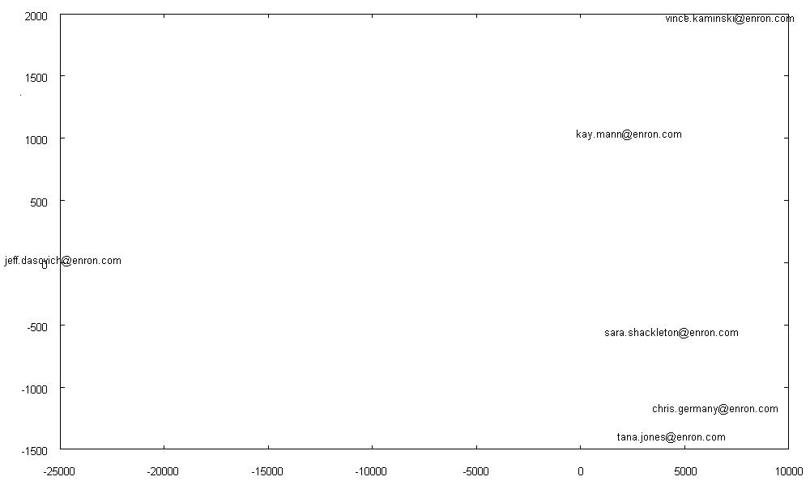
Results (cont.)

Slide 22
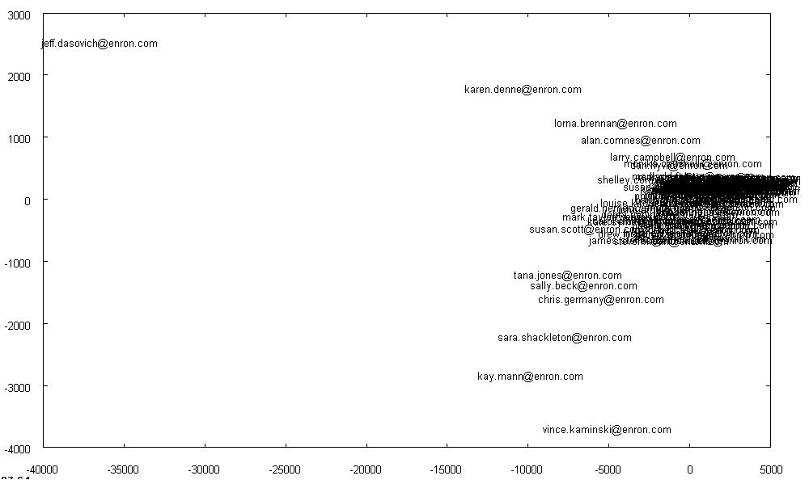
Results (cont.)

Slide 23
Conclusion
Because the 100 users had so few emails overall there was insufficient information for our approach
More preprocessing could strip emails into individual pieces providing more data—break threads apart—our code only handled 1 message in a thread
It would be worthwhile to reapproach the problem using centroids (geometric means) of the document vectors to group users, versus using Principal Component Analysis

Slide 24
Conclusion (cont.)
Thanks for your time.
Questions?
Mike Corbin, Patrick Trinkle
University of Maryland, Baltimore County
Spring 2009

